Slide 1


Taylor Swift Sentiment Analysis Using Twitter
ENSE 480
Mikayla Peterson (200425538)

Slide 2
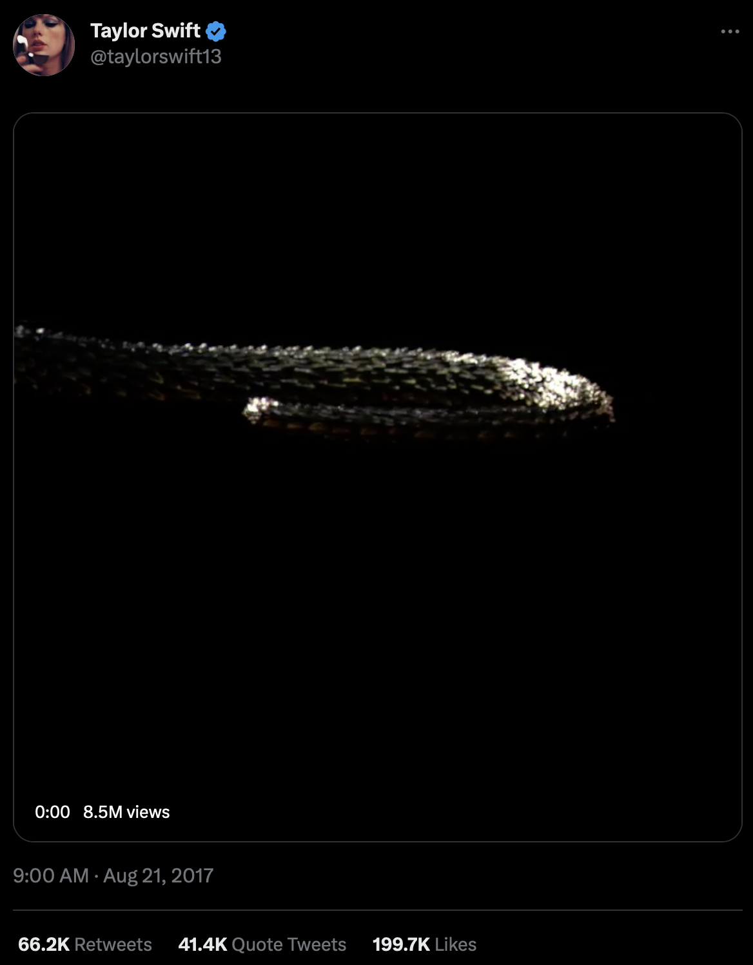
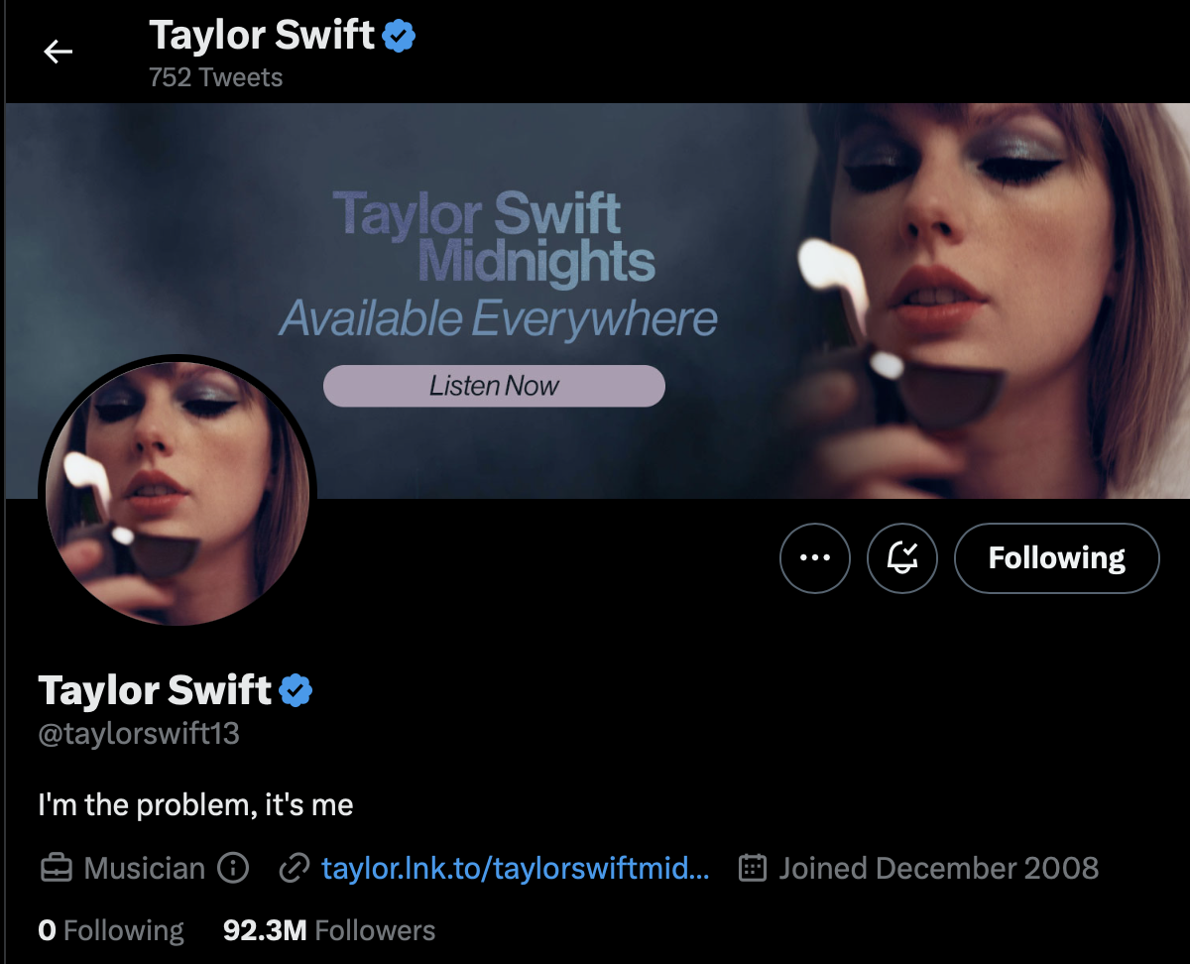
Problem
How has the public opinion and perceptions of Taylor Swift changed over the years?
Solution: sentiment analysis with natural language processing!

Slide 3
Scope
In-Scope
Collect and pre-process Tweets about Taylor
Perform sentiment analysis
Classifying tweets as positive, negative, or neutral
Visualizations of model performance and data trends
Out of Scope
No Taylor Nation tweets
Not separating the fans vs the public vs anti-fan classification

Slide 4
Techniques and Algorithms
Data collection
A library that accesses the Twitter API such as Tweepy
Pre-Processing and feature extraction
Natural Language Toolkit for Python (can do tagging and parsing)
Sentiment Analysis
Naïve Bayes model. Alternative is Support Vector Maps
Model Evaluation
Metrics like accuracy, precision, and f-score
Results Visualization
Matplotlib and/or an interactive dashboard
Jupyter Notebook

Slide 5
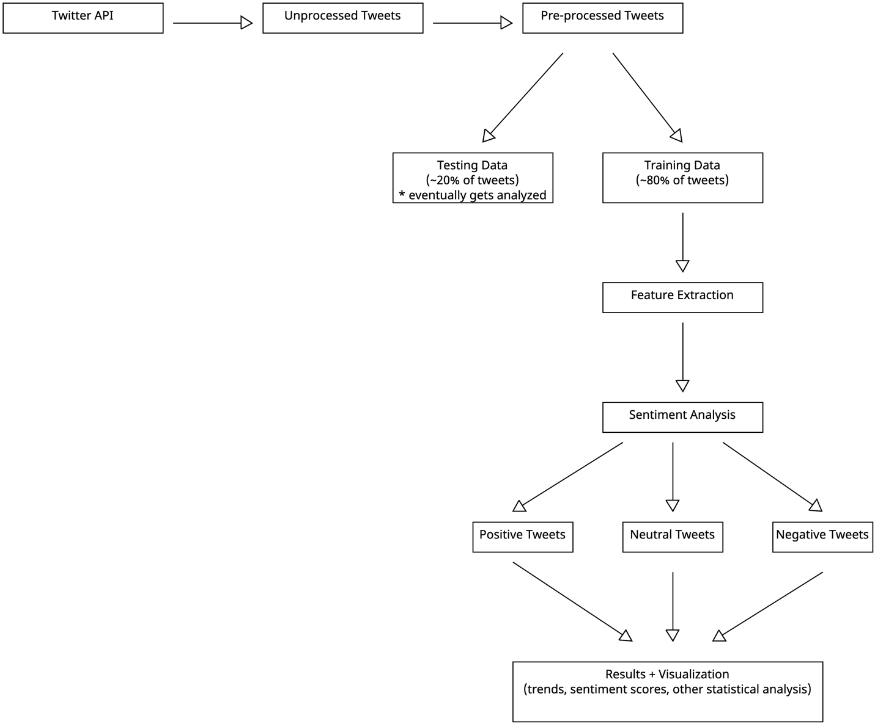
Structure Diagram

Slide 6

Questions?

Slide 7
Thank you for your time!

